Slide 1
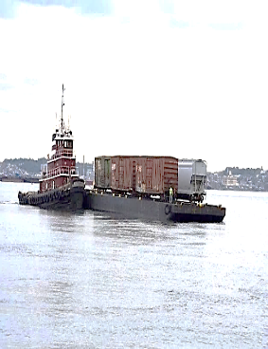
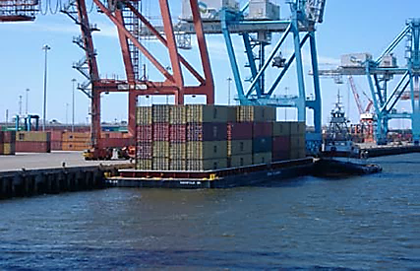
Oregon Public Ports Association
Maritime Administration Update on Grants and Financing Opportunities for Ports
September 27, 2024
Travis Black – Director, Inland Waterways Gateway – St. Louis

Slide 2
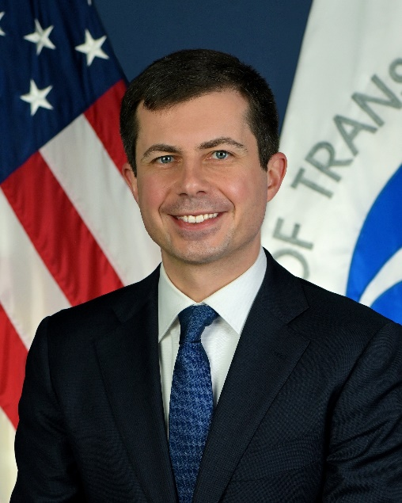
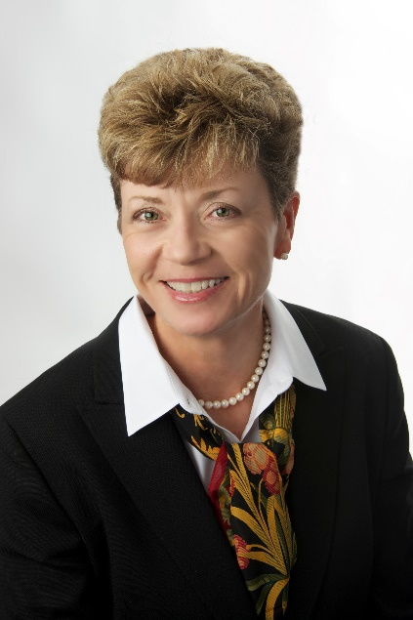

Mission
To foster and promote the U.S. Merchant Marine and the American maritime industry to strengthen the maritime transportation system — including landside infrastructure, the shipbuilding and repair industry, and labor — to meet the economic and national security needs of our Nation.
Established: 1950
Total Employees: 750+
Headquarters: 272
U.S. Merchant Marine Academy: 264
Gateway Offices and Fleet Sites: 218
Secretary of Transportation
Pete Buttigieg
Maritime Administrator
Rear Adm. Ann Phillips

Slide 3
Strategic Goals
MISSION: In Peace and In War
Strengthen the U.S. maritime transportation system including infrastructure, industry and labor to meet the economic and security needs of the Nation.
STRATEGIC GOALS
MARITIME CAPABILITIES: Develop domestic and international transportation opportunities to modernize and sustain a competitive commercial U.S.-flag fleet that ensures the Nation’s economic and national security
MARITIME READINESS: Ensure the availability of a capable U.S. Merchant Marine fleet with modern U.S.-flag vessels, skilled labor and global logistics support to drive the Nation’s economy and to meet national maritime transportation requirements in peacetime emergencies and armed conflicts. Drive innovation in the maritime industry.
INFRASTRUCTURE: Support the development of America’s ports, shipyards and related intermodal infrastructure as key integrated components of an efficient, resilient and sustainable national transportation system and freight network
ADVOCACY: Advance awareness of the necessity and importance of a strong U.S. Maritime Transportation System
Notes:
Make sure these are added to the color coded of the images I did on the other page

Slide 4
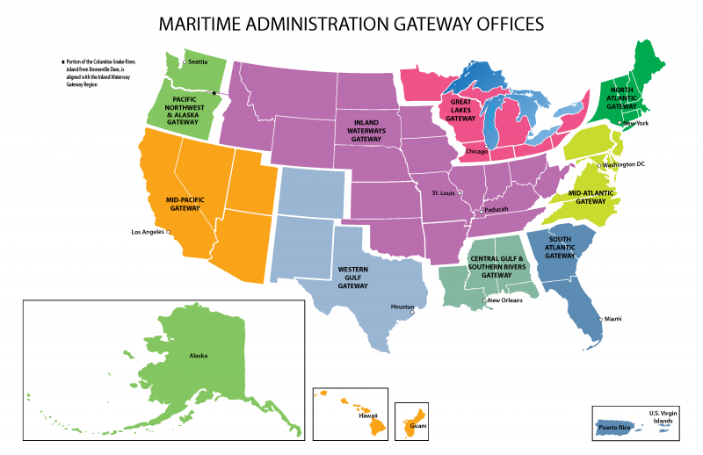
Office of Maritime & Intermodal Outreach – ‘Gateways’

Slide 5
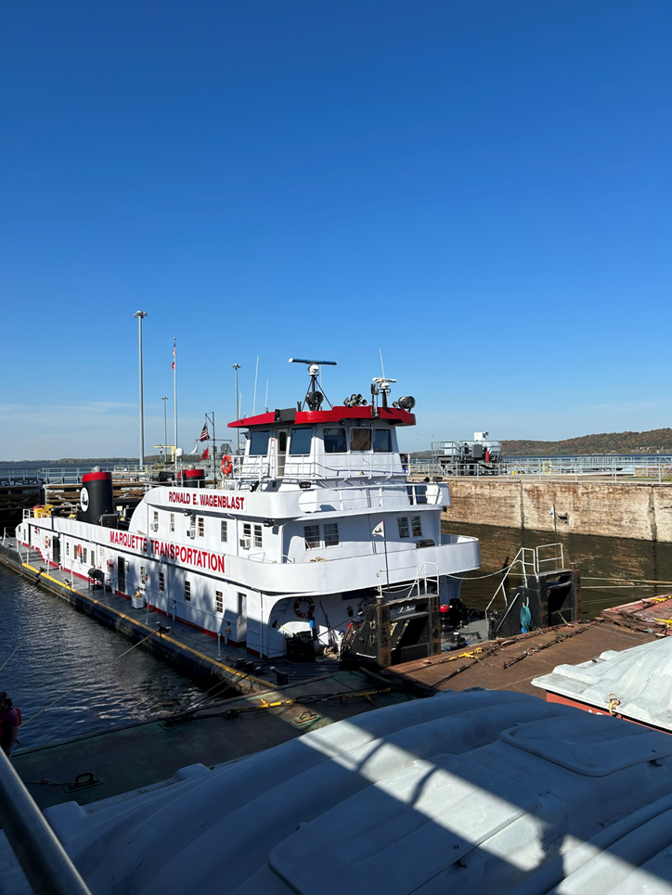
Office of Maritime & Intermodal Outreach – ‘Gateways’
Primary Responsibilities of the Gateway Director
Project Development/Grant Assistance
Develop projects in the region that promote overall economic growth, mitigate highway and port congestion, environmental compliance, and support both large and small American shipbuilding companies.
Intermodal Outreach
Outreach and engagement with Port Authorities, Terminal Operators, Carriers, Rail, Private Sector, local, state and federal partners, etc.
Maritime Security
Participate in Area Maritime Security Committee and Port Readiness Committee meetings held by USCG
Emergency Preparedness
Engage on federal maritime emergency preparedness issues in the region.
Strategic Seaports
Assess the readiness of our Strategic Commercial Seaports
Supply Chain Resiliency
Report supply chain impacts and port closures in times of emergency

Slide 6

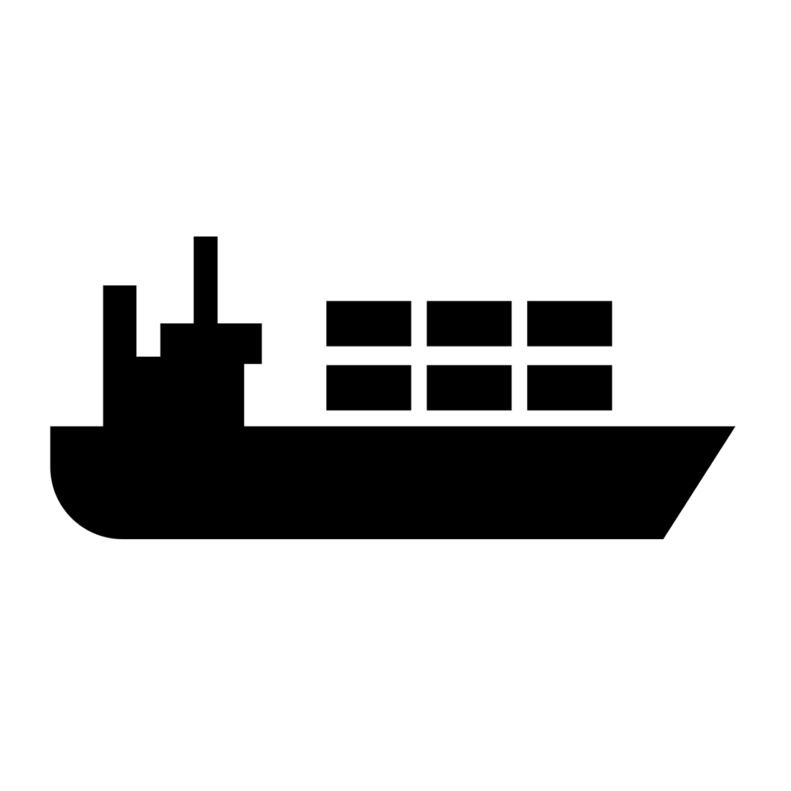

Gateway Director Role in Supporting MARAD’s mission..
Environmental Stewardship, Emergency Reporting, Military and Humanitarian Missions
Domain Awareness, Planning
Marine Highway
Vessel
Construction
Shipyard Grants
Berth, Shipyard
Yard
Community
Port Infrastructure to Move Freight - RAISE, PIDP, CRISI, TIFIA, RIFF, INFRA, Discretionary Grants/Loans, Port Security Grants….

Slide 7
Pre Award Grant Steps (typical)
Program authorized and appropriated funds by Congress
Notice of Funding Opportunity – Instructions to potential applicants
    Congressional Direction
    Administration Priorities
    Deadlines
    Format
Application Processing (eligibility)
Grant Technical Reviews – including Benefit-Cost Analysis where applicable
Senior Review Team
Selection by Secretary
Congressional Notifications
Recipient Notifications
Grant Agreement (6 mos. to 2+years)

Slide 8
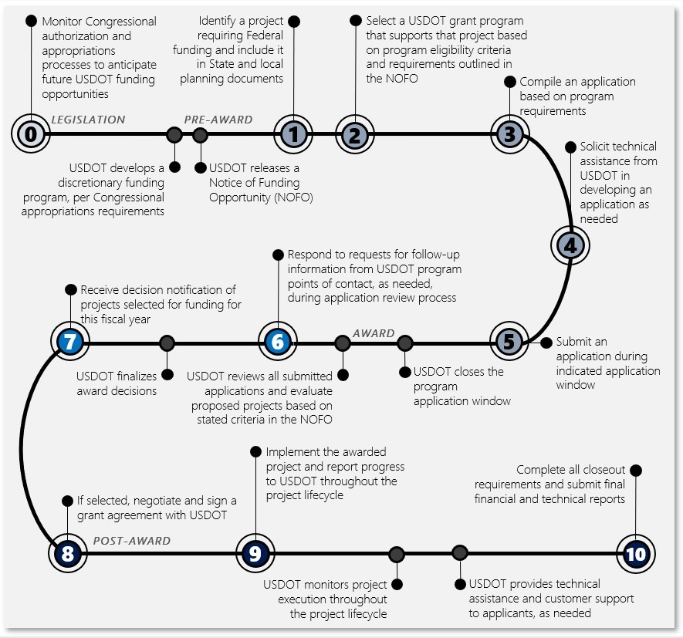
Applicant Roadmap

Slide 9

Discretionary Grants

Slide 10
Major USDOT Port Infrastructure Grant Programs
Rebuilding American Infrastructure with Sustainability and Equity (RAISE) ($5M - $25M, $1M Rural) Last NOFO issued November 30, 2023, closed February 28, 2024. $1.5 B for BIL five years. Also referred as TIGER and BUILD. Minimum Award $5M, ($1M Rural) Grants to be half urban half rural (200,000 pop). Next FY 2025 NOFO anticipated November 2024
Infrastructure for Rebuilding America (INFRA) ($25M - $100M, $5M Rural), FY 2024 and 2025 NOFO Closed May 6, 2024, $1.7 Billion last cycle. Minimum Award $25M ($5M rural) Max $100M
National Infrastructure Project Assistance (MEGA) (over $100M, 50% reserved for $500M+) FY 2024 and 2025 NOFO Closed May 6, 2024, $1.7 Billion last cycle.
Rural Surface Transportation (Rural) Grant Program, $780 Million last cycle, FY 2024 and 2025 NOFO Closed May 6, 2024. Highway, Bridge or Tunnel. 90% of grant awards over $25M, 10% less than $25M
Port Infrastructure Development Program (PIDP), Supplemental NOFO Feb 2024, FY 2024 NOFO closed May 10, 2024. Last cycle $500M available. Next FY 2025 NOFO Anticipated December 2024
United States Marine Highway Program (USMHP), May 20, 2024, FY 2024 NOFO closed July 12, 2024. $4.85M Available

Slide 11
Port Infrastructure Grant Programs
Port Security Grants, NOFO $90M FY 2024 PSGP were Due June 24, 2024. FEMA Grants - Port Security Grant Site https://www.fema.gov/grants/preparedness/port-security Notice of Funding Opportunity and Support Files download: https://grants.gov/search-results-detail/353552
MARAD Small Shipyards Grants $8.75M were DUE 8 May 2024 View the notice of funding opportunity.

Slide 12
Port Infrastructure Development Program (PIDP)
The PIDP, now in its fifth year, was established in FY2019 under 46 U.S.C. Section 50302
The primary statutory purpose of the PIDP is to make grants to improve the safety, efficiency, or reliability of the movement of goods through ports or intermodal connections to ports.
To date, 140 grants have been awarded totaling more than $2 billion for projects in 30 States and 3 Territories
PIDP grants can be awarded to coastal seaports, inland river ports, or Great Lakes ports
FY 2023 175 Applicants, 153 Eligible, 41 Selected $653M, $2.8B Requested
  25 States, 1 Territory
  15 Large Projects
  26 Small Projects ($172.8M) – $165.5M reserved for Small Projects
  24% Great Lakes and Inland Waterways
  61% In Rural Communities
  48% In Disadvantaged Communities

Slide 13
Port Infrastructure Development Program Grants
Eligible Applicants
A port authority, a commission or its subdivision or agent under existing authority;
A State or political subdivision of a State or local government;
An Indian Tribe;
A public agency or publicly chartered authority established by one or more States;
A special purpose district with a transportation function;
A multistate or multijurisdictional group of entities; or
A lead entity described above jointly with a private entity or group of private entities (including the owners or operators of a facility, or collection of facilities, at a port).

Slide 14
Port Infrastructure Development Program Grants
Small Projects at Small Ports
  A coastal seaport, Great Lakes, or inland river port to and from which the average annual tonnage of cargo during the 3 calendar years immediately preceding the time of application is less than 8,000,000 short tons as determined by U.S. Army Corps of Engineers data for the statistical area in which the project is located. MARAD may accept an independent certification of tonnage statistics only in those cases where U.S. Army Corps of Engineers statistical data is not available. For joint applications, MARAD will use the status of the lead (eligible) applicant when determining whether the project is for a small port.
  A project at small port requesting less than or equal to $11.25 million in Federal funding assistance through the FY 2024 PIDP.
  80% Federal share for small projects may be waived with approval of Secretary of Transportation
  Cost-effectiveness determinations (Benefit-Cost Ratio greater than 1) generally do not apply to Small Projects at Small Ports or to projects in non-contiguous States or territories. BUT, if Small Port proposes a project utilizing $11.25 million or more in Federal assistance, that project will be considered Large Projects, and the cost-effectiveness determination will apply (in contiguous states only)

Slide 15
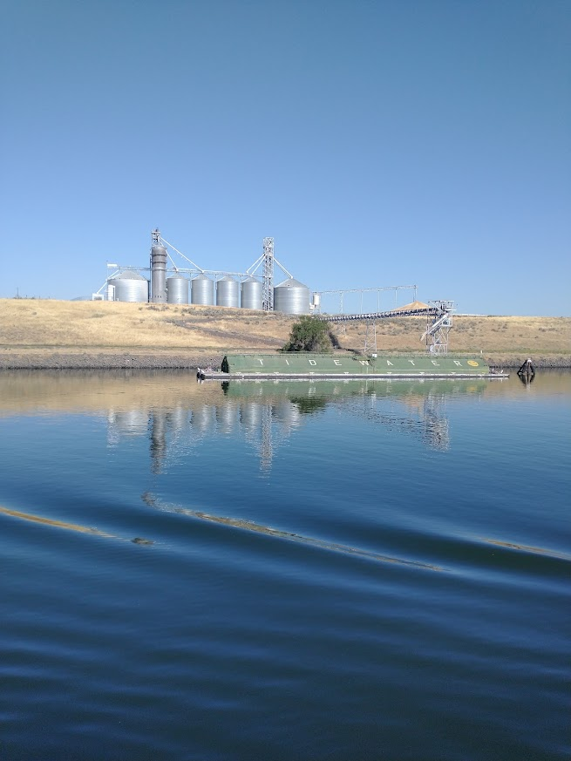
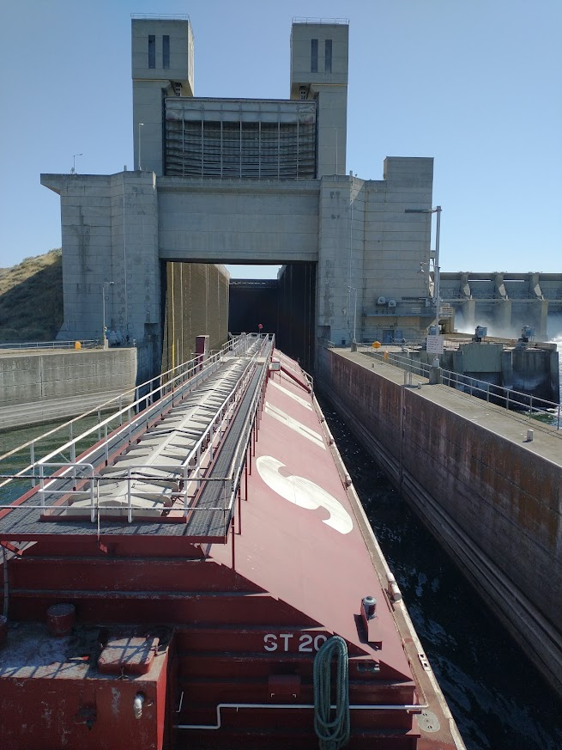
America’s Marine Highway

Slide 16
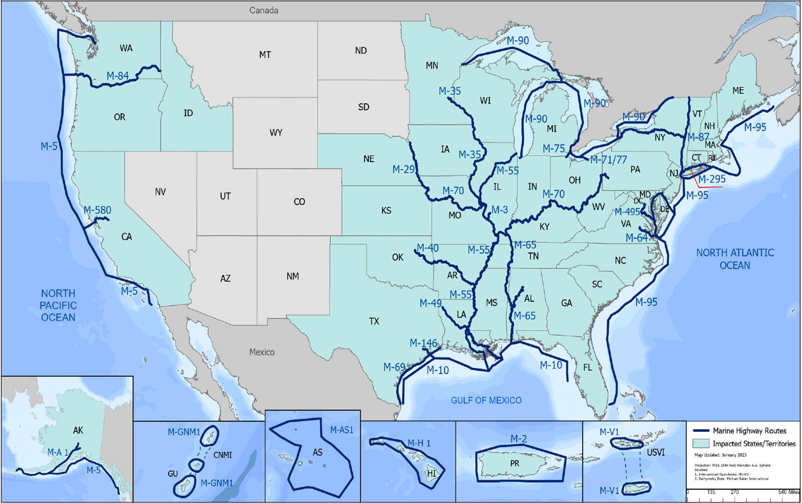
United States Marine Highway Program

Slide 17
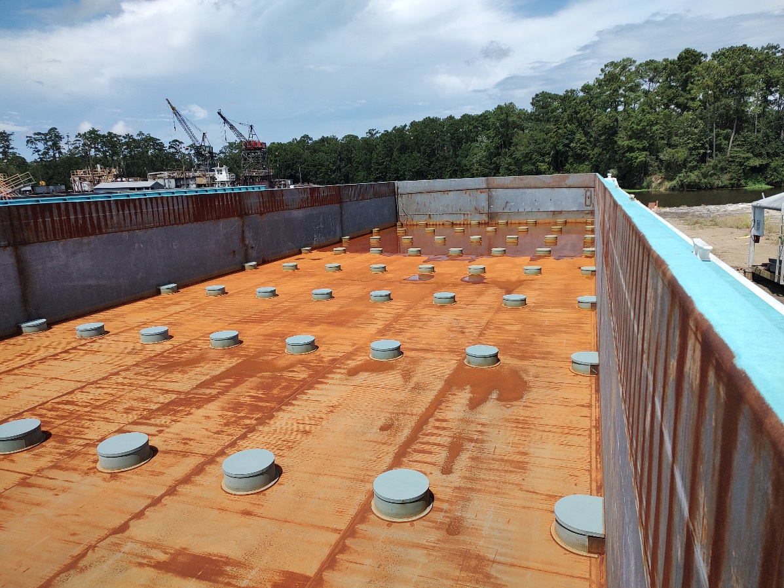
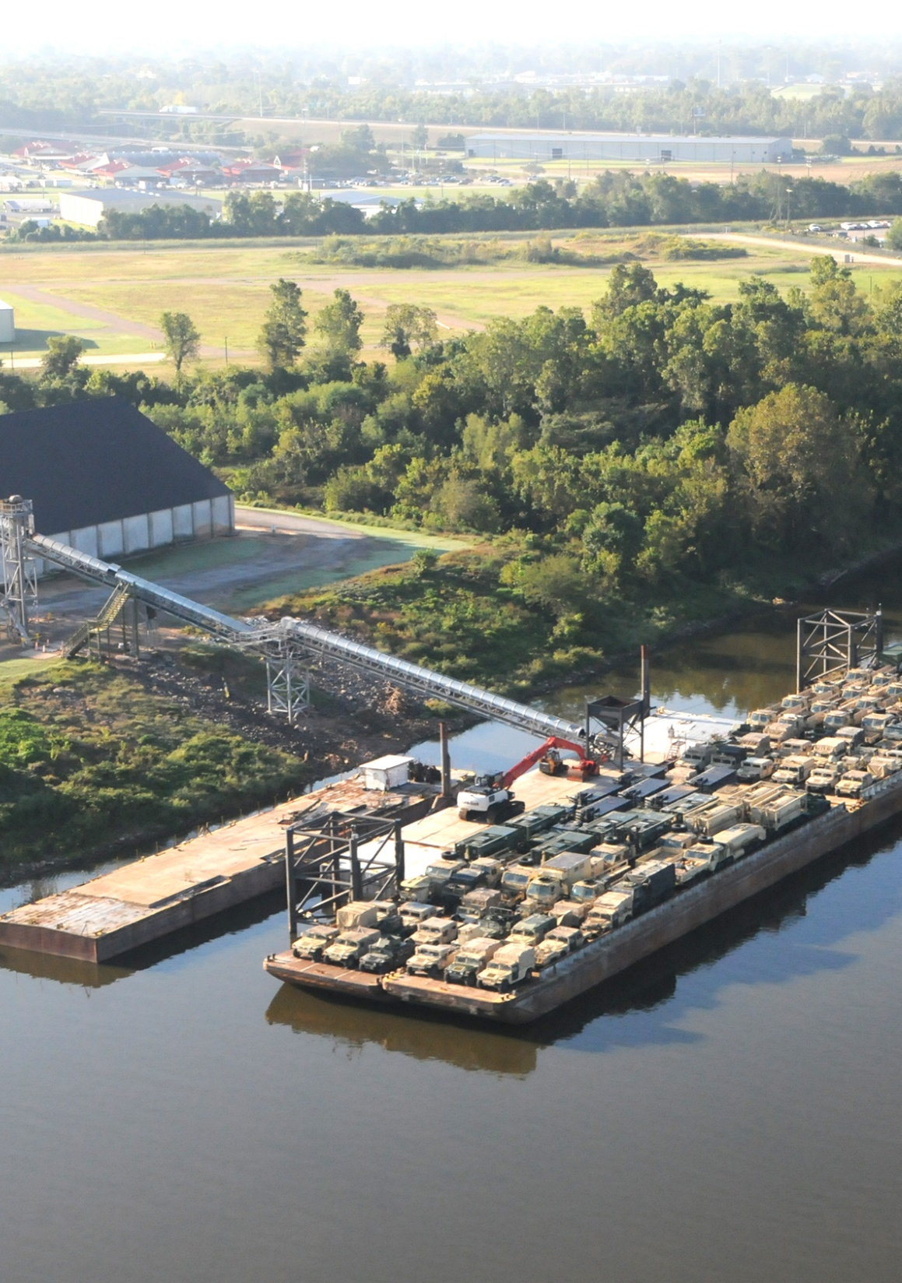
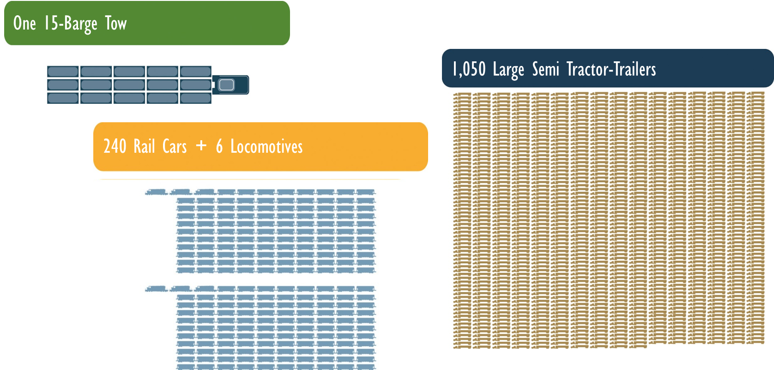
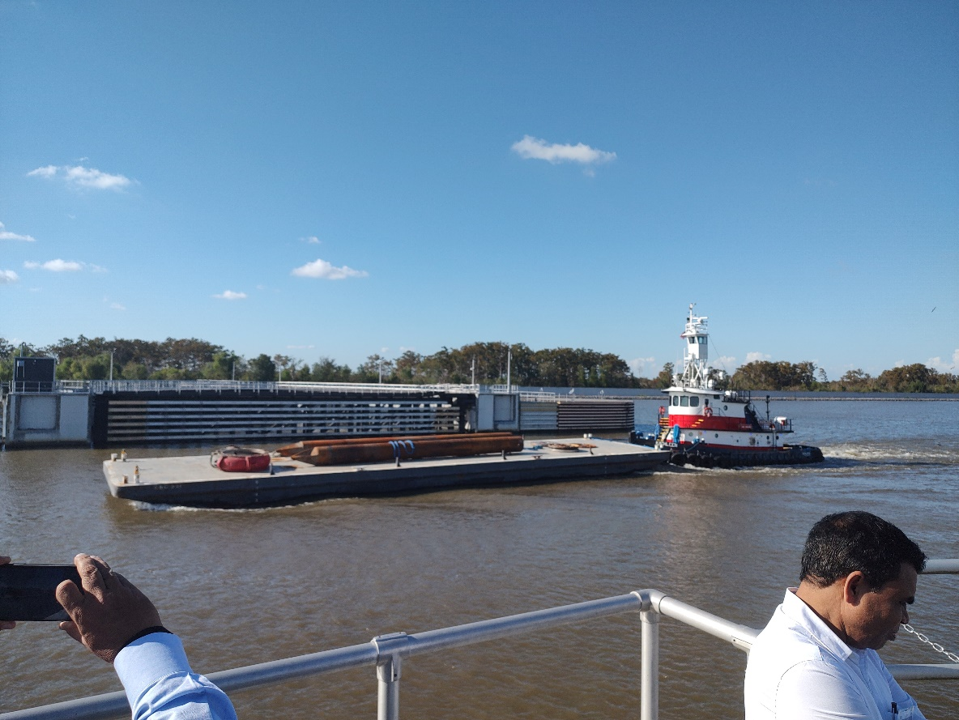
What is Divertible?

Slide 18
United States Marine Highway ProgramGrants
United States Marine Highway Program
What can Marine Highway Grant funds be used for?
  Port and landside infrastructure
  Cargo handling equipment
  New or used vessel purchase, lease, or modification
  Planning, preparation and design efforts in support of marine highway projects (cannot be used for market related studies)
  Private, Public and Tribal Entities are eligible to apply
  Final NOFO posted May 20, 2024,
  $4.85M for FY 2024
  Federal share - 80%
  Webinar on How to Apply will be held.
  FY 2024 Applications closed July 12, 2024
Notes:
Port Infrastructure Development Program grants to improve facilities within, or outside of and directly related to operations of ports.
This is an annual appropriation so even if you aren’t’ ready to submit this year, there will be another $450 million available each year for the next 5 years.
If and when Congress approves an appropriation bill we may see another $230 million allocated to the program .
$112.5 million is available for Small Projects at Small Ports – this is for projects under $11.25 million at ports that handle less than 8 million short tons during the previous 3 years.
Webinars are anticipated this month and links will be provided when they are available.
applications are due on May 16.

Slide 19
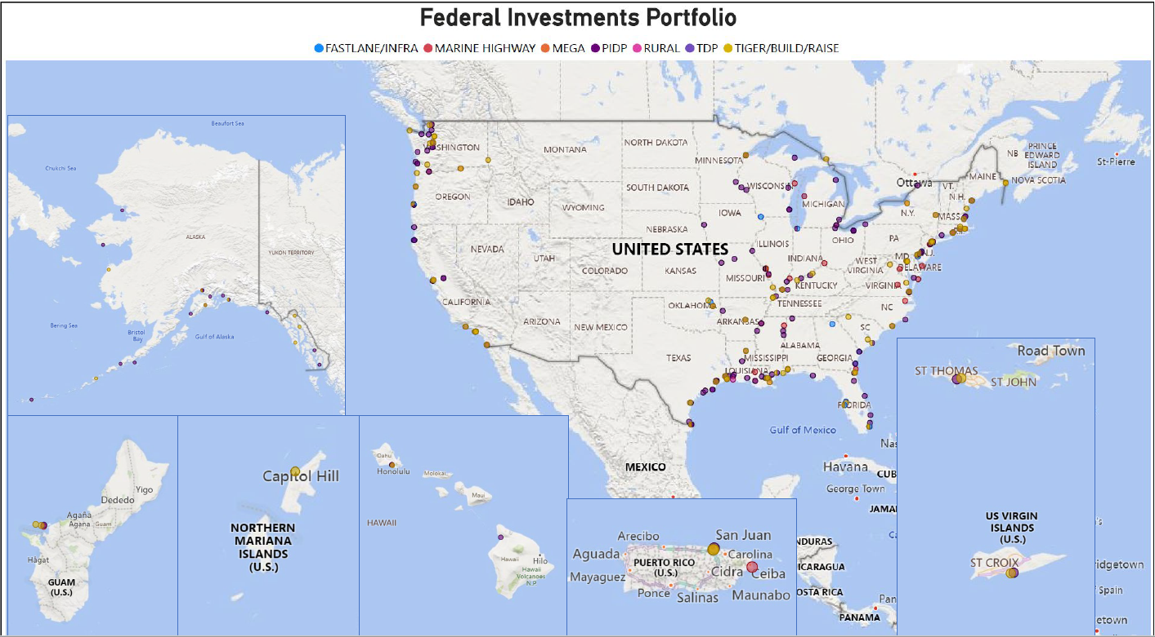

Slide 20
PIDP and Other Grants:
2023
PIDP Red Wing, Minnesota, $1.9M Grant. The project includes a bulkhead replacement and replacement of four existing dolphin clusters used for grain barge mooring at the Port of Red Wing’s barge fleeting offload–onload barge terminal.
PIDP Wabasha, Minnesota, Barge Terminal Project $2.5M Grant. Project constructs a new inland river barge terminal at Upper Mississippi River Mile Marker 760 and develop the necessary access road and utilities to support its operation.
PIDP Lewis County, Missouri - La Grange Multimodal Port Enhancement Project $11M Grant. Construct a new dry bulk cargo handling facility including roughly 200-foot cargo dock and approximately 1.62 miles of access road; the purchase and installation of a roughly 400- linear-foot conveyer system; and related cargo handling equipment.

Slide 21
PIDP and Other Grants:
2022
PIDP America’s Central Port District Granite City, Illinois Harbor Extension Project $4.5M ($4.1 M grant) extends the length of the harbor’s wharf by nearly 30% and creates a half‐acre of additional working space to support cargo dock operations.
PIDP Saint Paul (Minnesota) Port Authority Barge Terminal Dock Wall Rehabilitation $12.5 M ($4.1M grant) replaces the dock wall with a new tie-back system.
2012
TIGER Port of Lewiston, Idaho, Dock Extension $2.7 M ($1.3 M grant) 150 ft dock extension, mooring dolphin and fender system to existing container dock
2021
INFRA City of Dubuque, Iowa, Port and Rail Improvements $11.5 M ($5 M grant) renovate an existing fertilizer storage shed, replace and relocate rail track, new rail equipment (main line switch, loadout system and shed and rail-to-barge direct transfer system). Returned.

Slide 22
PIDP and Other Grants:
2022
PIDP Kaskaskia Regional Port District (Illinois) Phase 2 Rail Yard and Rail Corridor Improvements $10 M ($8 M grant) to install rail tracks create a rail yard near port terminal (6,000 ft of storage tracks) and upgrades to 5.3 miles of track to support bulk cargo.
PIDP Green Hills Regional Planning Commission Port Improvement and Expansion Project (for AGRIServices of Brunswick, Missouri) $10.9 M ($8.8 M grant) to create new container dock and related mooring structures, add a new rail spur with loading pit, construct a new 360’ x 140’ bulk agriculture supply building with conveyors between the rail and barge dock.
2023 Small Shipyard, Sunflower Enterprise, Inc., Dubuque, IA, $599,840 to support the purchase of a 100-ton marine travel lift.

Slide 23
PIDP and Other Grants:
2023
PIDP Monona County, Iowa, New Cooperative, Inc Port of Blencoe $10.2M Grant. The project will consist of constructing a new commodity handling facility, storage for liquid commodities, receiving and handling equipment, conveyors, elevating legs, and additional infrastructure such as internal road construction and site leveling to accommodate use of the southern side of the property for heavy industrial use.
2023
Small Shipyard, Mike's Inc. South Roxana, IL, $653,422 grant to support the purchase of a 30-ton rough terrain crane, telehandler, rack welder, and tig stick arc reach.
2020
PIDP, Oregon International Port of Coos Bay, OR, $9,880,000 grant for Phase II Rail Line tie and surfacing program and ballast for 121 miles of track from Eugene to Coos Bay Oregon.

Slide 24
PIDP and Other Grants:
2020
PIDP, Alaska Railroad Corporation, Alaska, received $19,779,425 grant to lengthen the Seward Alaska Marine Terminal to accommodate larger cargo ships and corridor improvements between the freight dock and an existing road.
2020
PIDP, Port of Bellingham, grant of $6,854,770 to make repairs and upgrades at the Bellingham Ship Terminal and eliminate rock outcroppings that limited navigation draft to 26 feet.
2020
PIDP, Northwest Seaport Alliance, received $10,687,333 for Terminal 5 Uplands modernization and rehabilitation project including paving, stormwater treatment and electric refrigerated plug capacity and rail infrastructure improvements.

Slide 25
PIDP and Other Grants:
2021
PIDP, Alaska Railroad Corporation, Alaska, received $1,173,600 grant to for a Whittier Terminal Master Plan that evaluates the safety, efficiency, state of good repair, reliability, resiliency and sustainability of the terminal.
2021
PIDP, Port of Tacoma, WA, received a $15,730,000 grant to improve 24.5 acres for empty containers and chassis work including new gates, guard shelter, fencing, lighting, stormwater and refurbishment of a railroad crossing adjacent to the site.
2021
PIDP, Illwaco, WA, received a $2,444,138 grant to reconstruct a wooden bulkhead and site utility work.
2022
PIDP, Port of Grays Harbor, WA, grant of $25,000,000, for Terminal 4 Redevelopment and expansion to accommodate unit trains and cargo handling laydown site (50 acres).

Slide 26
PIDP and Other Grants:
2022
PIDP, Port of Olympia, WA, received a $9,270,918 grant for replacing pavement on 21-acre cargo handling area, new maintenance facility and repairs at Cargo Berth 1.
2022
PIDP, Port of Port Angeles, WA, grant of $8,608,000 for an intermodal Handling and Transfer facility upgrade on 10 acres, including elevation and load capacity upgrades.
2022
PIDP, Swinomish Indian Tribal Community received grant of $11,073,627 for a Master Plan, design and construction of a commercial pier, boat ramp and mooring float.
2022
PIDP, Port of Portland, Oregon, grant of $24,360,000 for Terminal 6 Improvements at flexible cargo storage area and container storage areas. Stormwater improvements and electrical backups and other lighting and power system improvements.

Slide 27
PIDP and Other Grants:
2022
PIDP, Northwest Seaport Alliance, Washington, $17,035,900 grant for Terminal 5 new truck gate complex and cargo container storage yard.
2022
PIDP, Aleut Corporation, Alaska, $10,161,900 grant for Port of Adak Pier Five repairs of existing dock.
2022
PIDP, Prince William Sound Economic Development District, Alaska, $28,248,386 grant for three Prince William Sound ferry terminals.
2022
PIDP, Municipality of Anchorage, Port of Alaska, $68,700,000 grant for port modernization including replacement of sheet pile wall and shoreline revetment of armor rock as part of a North Extension Stabilization project.

Slide 28
PIDP and Other Grants:
2022
PIDP, Aleutians East Borough, Alaska, $5,365,000 grant for Sand Point Floating Dock and supporting access, utility and safety infrastructure.
2023
PIDP, City of Kotzebue, Alaska, $2,455,485 grant for feasibility, cost-benefit analysis, site surveys, geotechnical investigations and other project planning activities for a potential Cape Blossom Port.
2023
PIDP, Metlakatia Indian Community, Alaska, $3,384,439 grant for Metlakatia Port Improvement project including fender system replacement and rehabilitation of breakwaters. Also repairs to boathouse and haul-out system.
2022
PIDP, City of Nome, $11,250,000 grant for water, wastewater, fuel, power, and communication infrastructure for expansion and deepening the port.

Slide 29
PIDP and Other Grants:
2023
PIDP, Port of Astoria, Oregon, $25,315,758 grant for Pier 2 West rehabilitation including new bulkhead, removal of timber dock, Pier 2 warehouse, slab repairs, stormwater drainage system, waterline and fire protection.
2023
PIDP, Coquille Indian Tribe, Oregon, $7,729,649.86 grant for Dock repairs of the Ko’Kwel Wharf.
2024
PIDP, Port of Astoria, Oregon, $1,000,000, grant for preconstruction activities related to Pier 2 rehabilitation (engineering, permitting, mitigation expenses).
2024
PIDP, Southwest Oregon International Port of Coos Bay, Oregon, $13,573,133 grant for maintenance and repair of rail linen track on Coos Bay Rail line.

Slide 30
PIDP and Other Grants:
2024
PIDP, Port of Garibaldi, Oregon, $1,474,761 grant for Commercial Avenue Wharf improvements including roadway, power and other utilities, sidewalks, boat launch and parking.

Slide 31
US Marine Highway Grants examples:
2022 USMH
Washington & Oregon Tidewater M-84 Barge Service Expansion $4,168,759 Tidewater Barge Lines, Inc. The grant will support an electric dock crane at the Port of Vancouver, WA. This equipment will help meet the demand for additional shipments of municipal solid waste and other waste through the Columbia River Marine Highway M-84.
2020 USMH
Tidewater Barge Lines, Inc, Port of Morrow, Oregon, M-84 Barge Service Expansion $3,200,000 Sponsored by the Port of Morrow, the grant was awarded to support the procurement of a container on barge service to expand from the Port of Morrow in Boardman, OR, to Vancouver, WA.
2019 USMH
Port of Morrow, Port of Morrow, Oregon, M-84 Barge Service Expansion $1,623,200 The grant was awarded for the expansion of barge services from Portland, Oregon, to Vancouver, Washington, and to enhance the Port of Morrow barge capacity.

Slide 32
US Marine Highway Grants:
2023 USMH
The Kaskaskia Regional Port District, Illinois, was awarded $1,008,750 for the acquisition of eight shuttle cars which will handle 2.25 million tons of new coiled steel and move existing coiled steel located at the terminal to a new laydown yard.
2022 USMH
SCF Lewis and Clark Terminals (America’s Central Port, Granite City, Illinois) M-55/M-35 $3.4M project to purchase four modern, fuel efficient, and environmentally friendly Hyster forklifts, a Manitowoc Cable Crane to load/unload unitized cargo onto barges, and a barge winch system to load/unload unitized cargo onto barges.
2020 USMH
America’s Central Port (Granite City, Illinois) M-55/M-35 $1.6 M ($1.3 M grant) purchase a used 275-ton crane, 18 cameras and a container tilter.

Slide 33
US Marine Highway Grants:
2023 USMH
The Port of Bellingham, Washington, was awarded $1,021,747 for the acquisition of a portable barge ramp.
2023 USMH
Matanuska-Susitna Borough, Alaska was awarded $944,804 to purchase a 75-ton rough terrain crane at Port MacKenzie.
2023 USMH
SeaTac Marine Services, was awarded $1,014,957 to purchase a Tier 4 forklift for Alaska bound cargo at their Duwamish River terminal in Seattle.

Slide 34

Other Paths– Other Resources Available

Slide 35
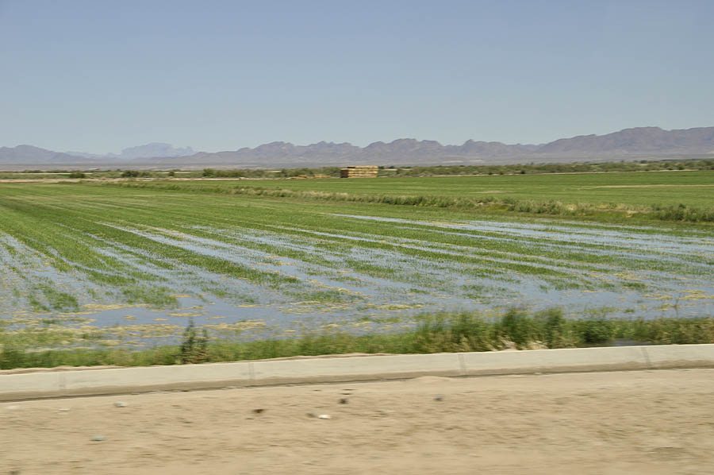
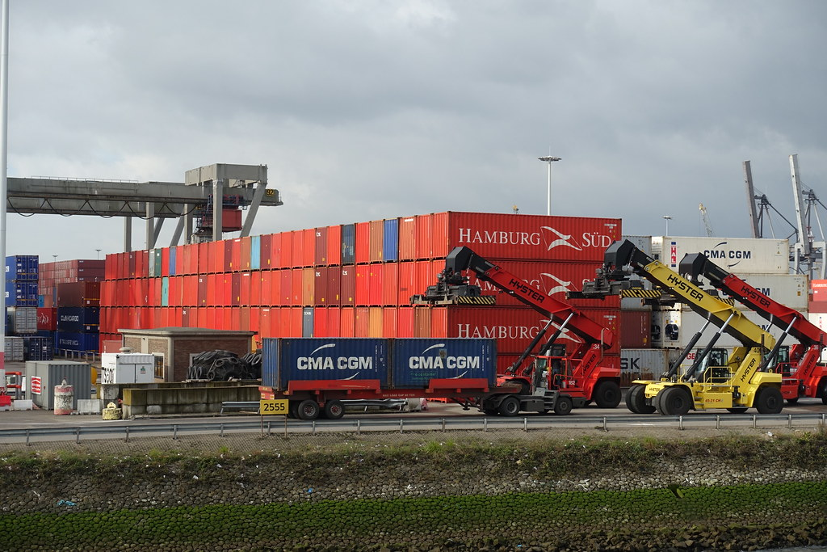
Port Conveyance Program
Port Conveyance Program
Designed to temporarily transfer the use and management of excess Federal property to States and local governments for the purposes of port development, port expansion, and operation of port facilities.
MARAD receives, evaluates, and approves applications from prospective grantees to make recommendation for assignments of surplus property to be used for the development or operation of a port facility.
Conveyance involves no monetary consideration, provided the property is used and maintained in perpetuity as a port facility.
https://www.maritime.dot.gov/ports/port-conveyance/port-conveyance

Slide 36
USDOT Transportation Infrastructure Finance and Innovation Act (TIFIA)
Financing assistance for surface transportation projects
https://www.transportation.gov/buildamerica/financing/tifia
Credit assistance limited to 33 percent of reasonably anticipated eligible project costs (unless the sponsor provides a compelling justification for up to 49 percent)
USDOT Railroad Rehabilitation & Improvement Financing (RRIF)
Financing assistance for railroad infrastructure
https://www.transportation.gov/buildamerica/financing/rrif
Loan – up to 100%

Slide 37
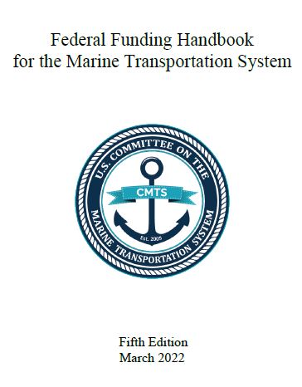
Federal Funding Handbook – prepared by CMTS
Compilation of marine transportation system-related Federal funding programs
Table of Contents and Appendices organize programs by category, alphabetical order, agency, and assistance type
Clickable links navigate users through the handbook, to program websites, and to program POCs
Programs provide hundreds of millions of federal dollars to invest in the infrastructure that supports the U.S. Marine Transportation System
Note: this document was prepared by the Committee on Marine Transportation Systems, a collaborative of multiple federal agencies.
Link to handbook
6th edition coming soon!

Slide 38
Federal Railroad Administration
FRA Consolidated Rail Infrastructure and Safety Improvement (CRISI) Discretionary Grant Program
Funds projects that improve the safety, efficiency, and reliability of intercity passenger and freight rail
$2.4 billion was available for FY 2023-24
https://railroads.dot.gov/grants-loans/competitive-discretionary-grant-programs/consolidated-rail-infrastructure-and-safety-2
Eligible projects include those that address congestion challenges, highway-rail grade crossings, and workforce development and training; and those that upgrade short line or regional railroad infrastructure, relocate rail lines, improve intercity passenger rail capital assets, and target railroad trespassing.
At least 25 percent of available funds are reserved for projects in rural communities.
DUE MAY 28, 2024

Slide 39
FHWA Reduction of Truck Emissions at Port Facilities
$80M per year (FY 2022-2026). New program under BIL.
NOFO for $160M for FY 2022 and FY 2023. Applications were due July 26, 2023.
https://www.fhwa.dot.gov/bipartisan-infrastructure-law/rtep.cfm
Grants funding to test, evaluate, and deploy projects that reduce port-related emissions from idling trucks, including through the advancement of port electrification and improvements in efficiency, focusing on port operations, including heavy-duty commercial vehicles, and other related projects.

Slide 40
Thank You For Your Attention
Travis Black
Director, Inland Waterways Gateway – St. Louis
(202) 264-0433 Travis.Black@dot.gov
Xochitl Castañeda
Director, Pacific Northwest and Alaska Gateway
(503) 819-5260
Xochitl.Castaneda@dot.gov
Notes:
I understand that was a very high level overview – but the Gateways are here to assist stakeholders in navigating the many grant programs available through the USDOT and our sister agencies.
We are going through a process to increase our outreach to MPOs and RTPOs and trying to encourage port involvement in the transportation planning processes.
Here is my contact information and contact information for Chad Dorsey my colleague out of Paducah.
Thank you again for allowing me to come and speak to you.

